Slide 1
R/RStudio
Taylor Dunivin
EDAMAME
July 26, 2018

Slide 2
Why R?
free
open-source
designed for data analysis and statistics
user-community
highly extensible
easy organization with RStudio

Slide 3
R community
www.r-bloggers.com
Twitter
@hadleywickham
@rstudiotips
support.rstudio.com

Slide 4
RStudio
Notes:
https://support.rstudio.com/hc/en-us/articles/200532077?version=1.0.143&mode=desktop

Slide 5
Console vs. script
SCRIPT
Preserve work in a plain-text file (.R extension)
Do your work here, and save this to be able to reproduce or edit it at a later date
CONSOLE
Yame as typing R in your command line
You can type in commands and R will execute them and print the result
Pro tip: cmd/ctrl-enter executes the line the cursor is on by copying that line and sending it to the Console
Notes:
Mixes interactivity and preservation
Save just text and can get same results at another time or on another machine
Building preservable pipeline of operations

Slide 6
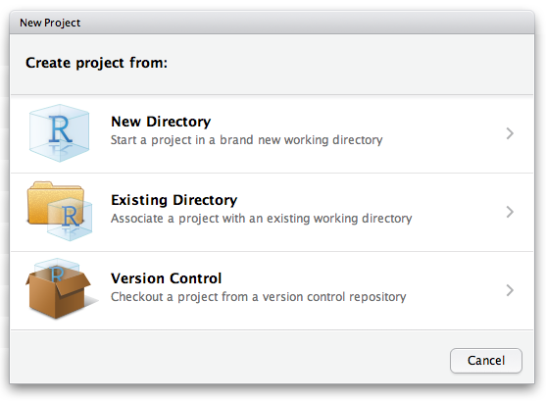
Organization in Rstudio (Projects)
File → New Project

Slide 7
Organization in Rstudio (Projects)
File → New Project
What’s included in an R Project?
.Rproj extension
Self-contained home for
code
data
output
figures
.gitignore
Working directory = project directory

Slide 8
Special features
ignoring whitespace
tab completion
objects
packages
assignment within a function
Consistent documentation/ help files
?function
??anything
R is chatty
error messages
warning messages

Slide 9
Data types in R
Same data type
Mixed data types
Vector
List
1 dimension
Numeric
Logical
Character
Factor
Matrix
Data frame/
Tibble
2 dimensions
Array
N dimensions

Slide 10
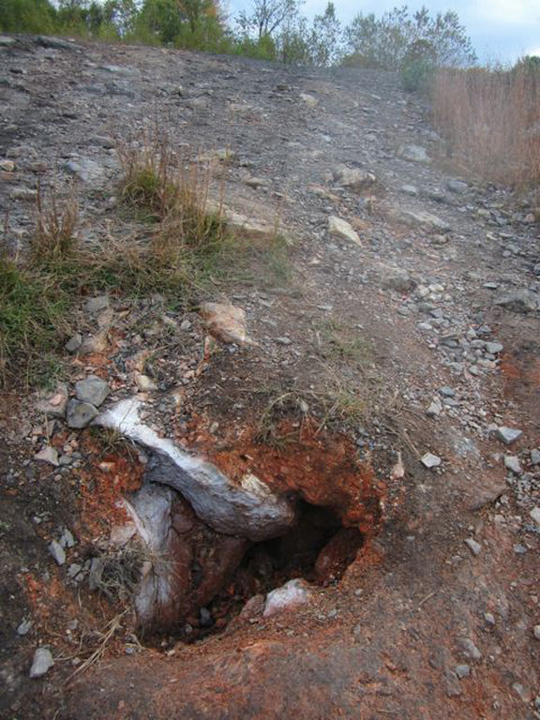
Today’s data: Centralia, PA
Introduction
Coal mine fire ignited in 1962
Underground fire moves along coal seam
Compounded stressors
Thermal disturbance
Coal combustion pollutants
(Janzen & Tobin 2008)
Notes:
The disturbance that I study is Centralia pa, the site of an underground coal mine fire
pA coalmine fire ignighted back in 1962. the fire progresses along the coal seam, allowing areas once affected to cool and recover from the thermal disturbance … creating a chronosequence of fire affectedness
This system thus exposes microbial communities to a multitude of stressors including both thermal disturbance from the fire and coal combustion pollutants which can include arsenic, since it is naturally present in coal

Slide 11
Sampling stragegy
Fire history
Fire-affected
Recovered
Reference
(Lee & Sorensen, et al,. 2016)
Notes:
For this work, my goal is to use metagenomes collected from Centralia soils to Compare the distribution and diversity of arsenic resistance genes along along the Centralia chronosequence of fire affectedness
Here is a map of centralia. The fire origin is depicted here and affected soil temperatures align along two firefronts. Along the firefronts there are areas that were one affected by the fire but currently do not have elevated temperatures (~15C)… we have soils depicted in red with currently elevated temperatures which range from about 20C to 57C
And we also have two reference soils that have never been shown to be impacted by the fire.

Slide 12
Break!

Slide 13
Data visualization
Taylor Dunivin
EDAMAME
July 26, 2018

Slide 14

Grammar of graphics

Slide 15

ggplot: for (almost) all of your plotting needs
uses the grammar of graphics
links layers with
first layer is an umbrella layer

